Slide 1




RESTAURANT
MANAGEMENT
SYSTEM
Presented By
Hospitality Hub

Slide 2



OUR TEAM
Ananda Neupane
Smriti Karki
Adam Pokhrel
Piyush Phuyal
Toya Chaudhary
(Project manager)
(Business analyst)
(Developer)
(Developer)
(Developer)

Slide 3


PROJECT OVERVIEW
Build for a restaurant named One bite to adapt with mobile application technology
And also overcome the peak hour rushes
Comprehensive tools to provide streamline operation in restaurant industry.
Primarily focus on three aspects of order management from reservation, take-away and dine n customers

Slide 4



PROJECT GOAL
Streamline Order Processing
Enhance Customer Experience
Efficient Menu Management
Optimize Staff Management
Reporting and Analytics:

Slide 5


PROJECT FEATURES
Takeaway Orders:
Dine - In Orders
Easy user interface for staff
Manage tables
Order modification as per customer wish
User-friendly interface for customers
Multiple payment options
Order history and reordering options.

Slide 6
PROJECT FEATURES
Reservation and preorder food
Dynamic menu
Admin can add and remove items
Real -time updates to customer site menu
Online reservation with date and time
Customize dine-in time
E-mail verification on confirmation

Slide 7

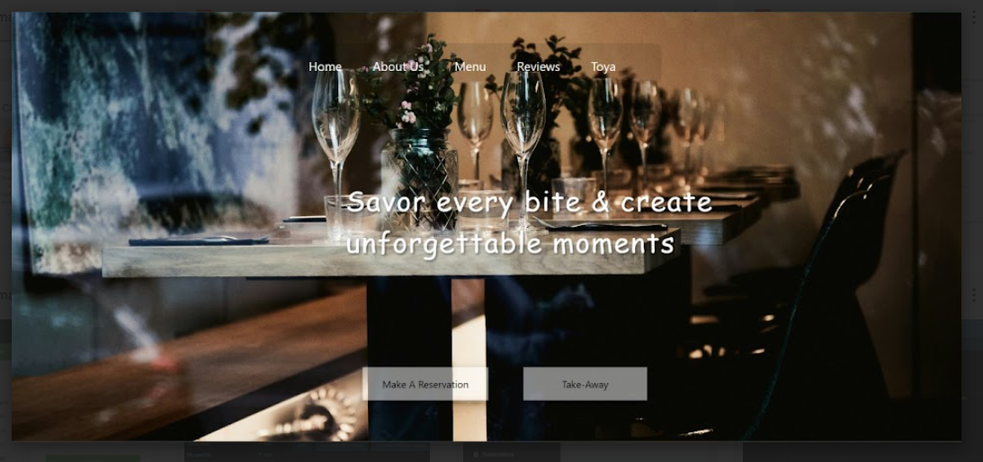
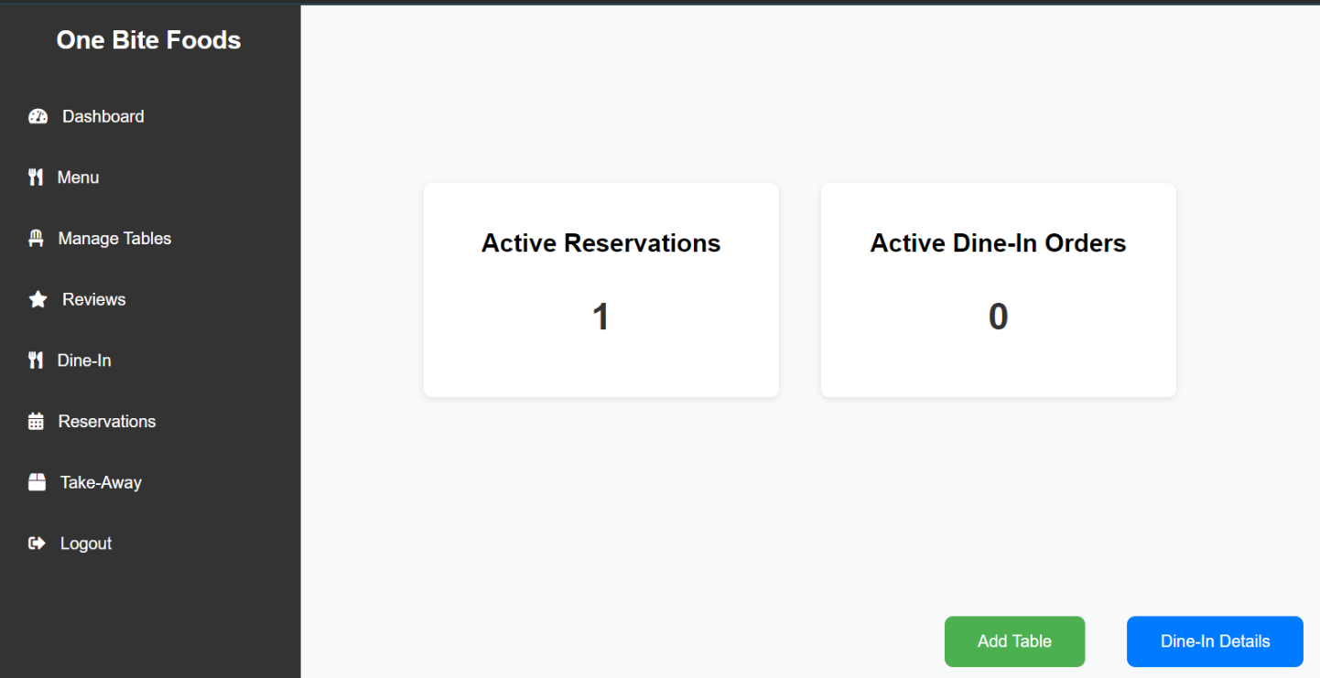

DELIVERABLES

Slide 8
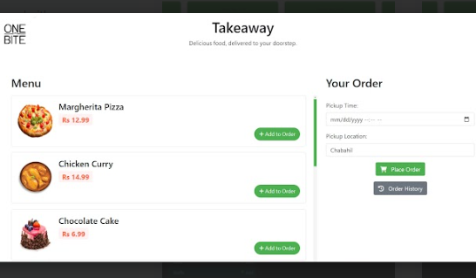
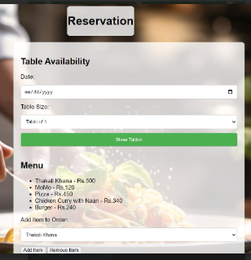
DELIVERABLES

Slide 9
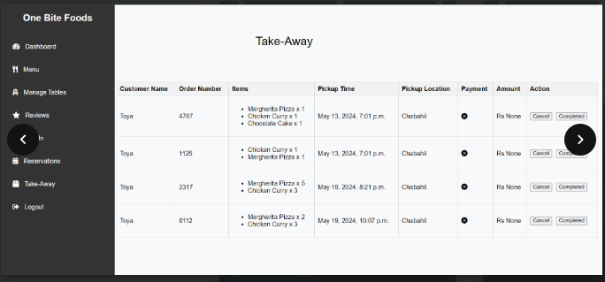
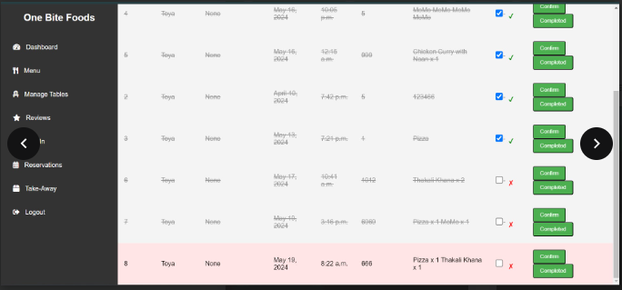
DELIVERABLES

Slide 10
FUTURE ENHANCEMENT PLANS
Enhanced Customer Engagement Features
Inventory Management
Customer Feedback and Interaction
Enhanced Reservation and Waitlist Management
Advanced Analytics and Reporting

Slide 11

Thank You

